Slide 1

Lecture 13
Chapter 23: Trees
Chapter 26: A Heap Implementation

Slide 2
Contents
Tree Concepts
Hierarchical Organizations
Tree Terminology
Traversals of a Tree
Traversals of a Binary Tree
Traversals of a General Tree
Java Interfaces for Trees
Interfaces for All Trees
An Interface for Binary Trees

Slide 3
Contents
Examples of Binary Trees
Expression Trees
Decision Trees
Binary Search Trees
Heaps
Examples of General Trees
Parse Trees
Game Trees

Slide 4
Objectives
Describe binary trees, general trees, using standard terminology
Traverse tree in one of four ways: preorder, postorder, inorder, level order
Give examples of binary trees: expression trees, decision trees, binary search trees, and heaps
Give examples of general trees: including parse trees, game trees

Slide 5
Tree Concepts
A way to organize data
Consider a family tree
Hierarchical organization
Data items have ancestors, descendants
Data items appear at various levels
Contrast with previous linearly organized structures

Slide 6
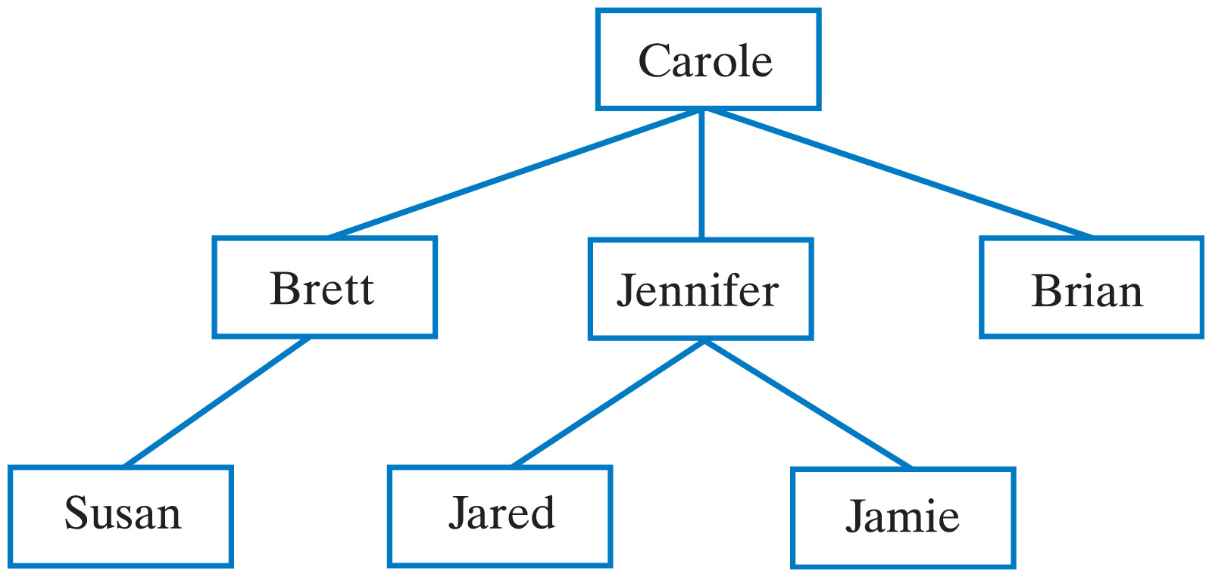
Hierarchical Organization
Example: Family trees
Carole's children and grandchildren.

Slide 7
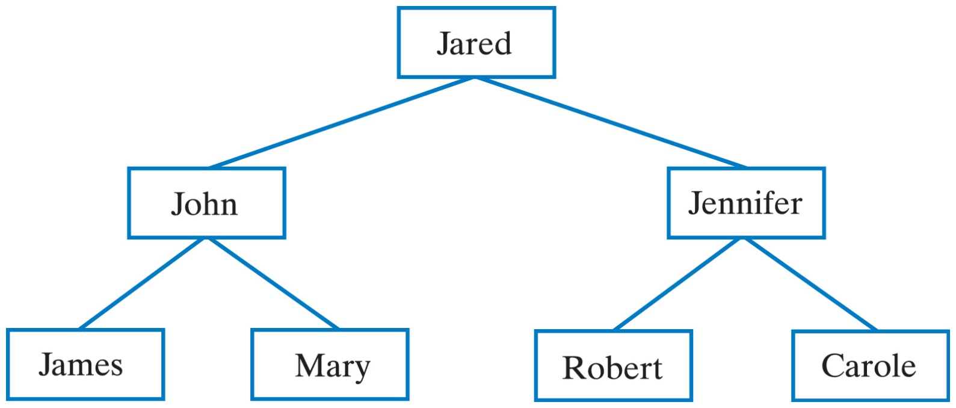
Hierarchical Organization
Example: Family trees
Jared's parents and grandparents.

Slide 8
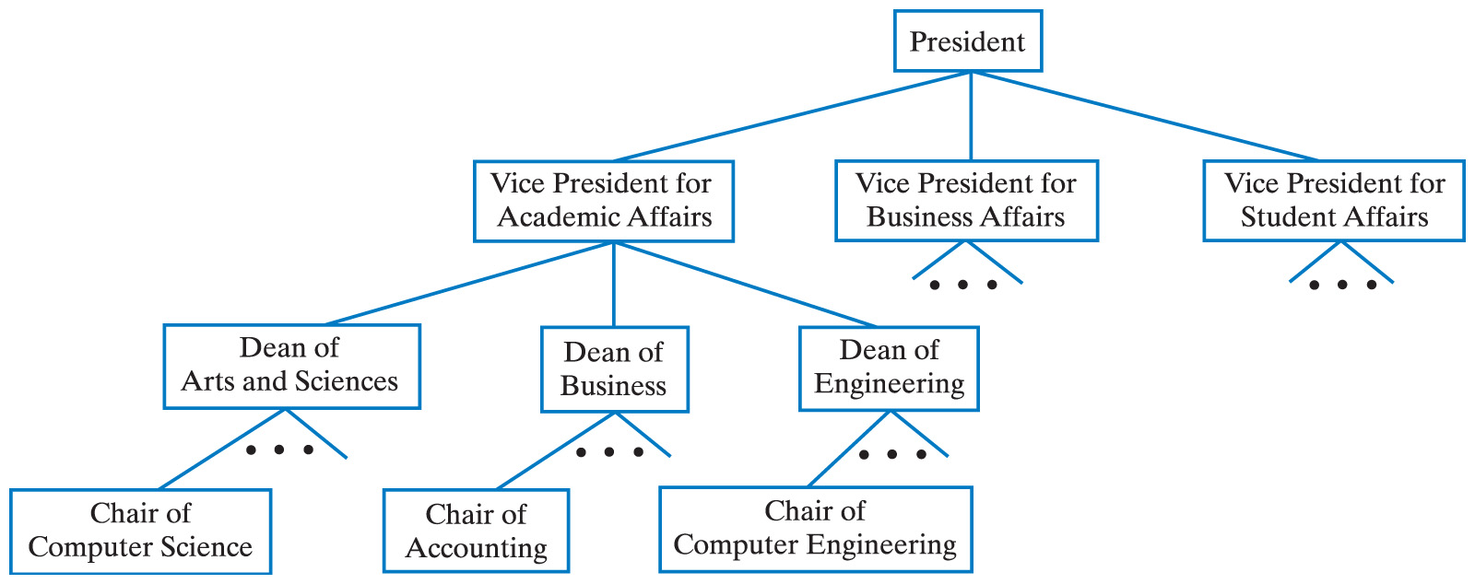
Hierarchical Organization
Example: A university's organization
A university's administrative structure.

Slide 9
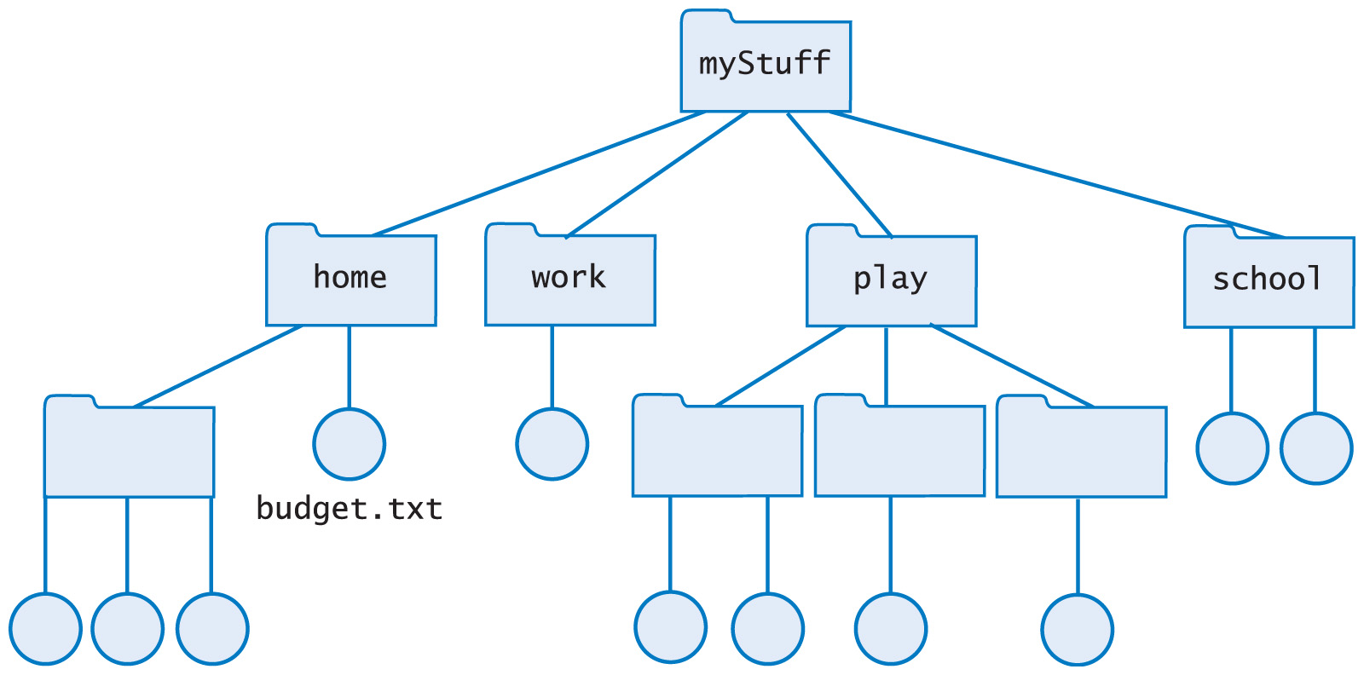
Hierarchical Organization
Example: File Directories
Computer files organized into folders

Slide 10
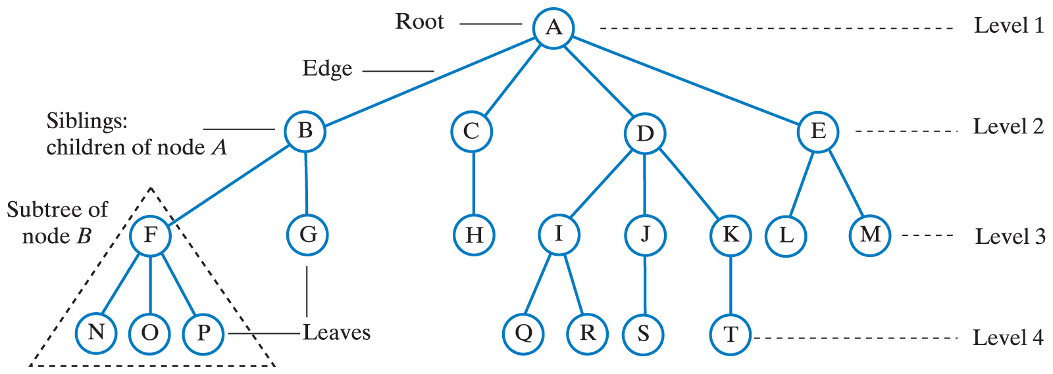
Tree Terminology
A tree is a set of nodes connected by edges
The edges indicate relationships among nodes
Nodes arranged in levels
Indicate the nodes' hierarchy
Top level is a single node called the root
Nodes at a given level are children of nodes of previous level
Node with children is the parent node of those children
Nodes with same parent are siblings
Node with no children is a leaf node
The only node with no parent is the root node
All others have one parent each

Slide 11
Tree Terminology
Empty trees?
Some authors specify a general tree must have at least the root node
This text will allow trees to be empty
A node is reached from the root by a path
The length of the path is the number of edges that compose it
The height of a tree is the number of levels in the tree
The subtree of a node is a tree rooted at a child of that node

Slide 12
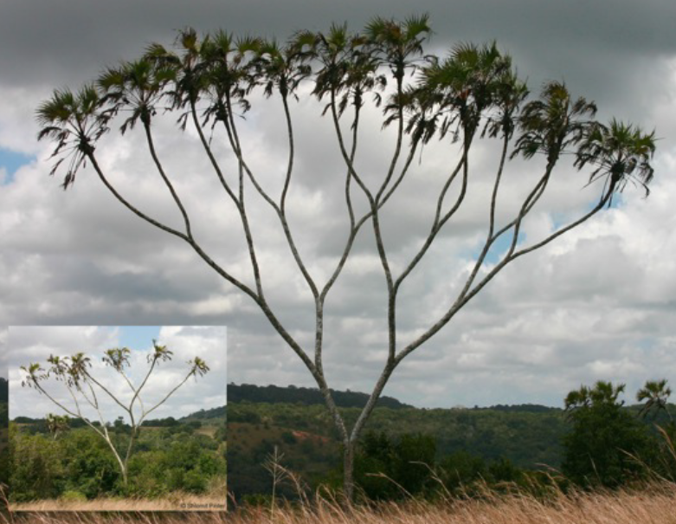
Binary Trees

Slide 13
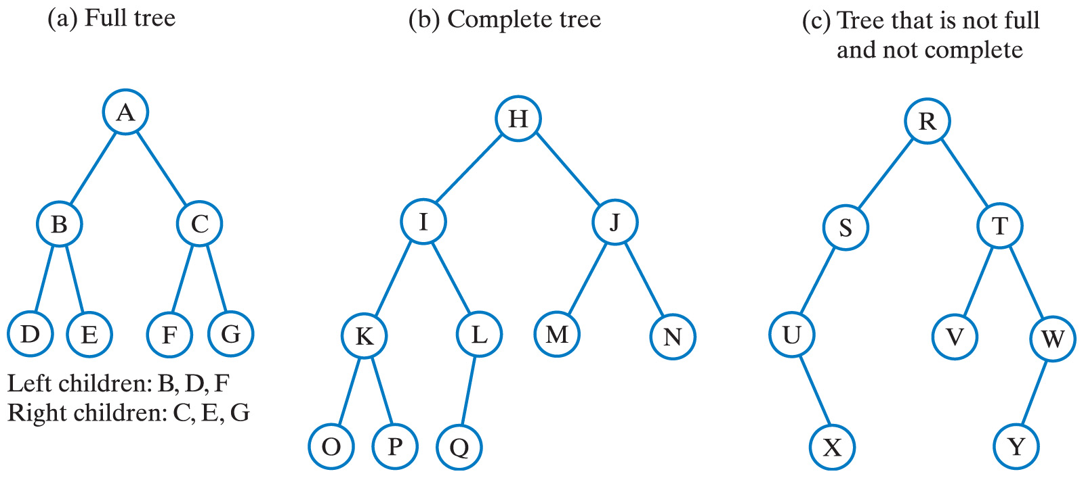
Binary Trees
Each node has at most two children
Every non-leaf in a full binary tree has exactly two children
A complete binary tree is full to its next-to-last level
Leaves on last level filled from left to right

Slide 14
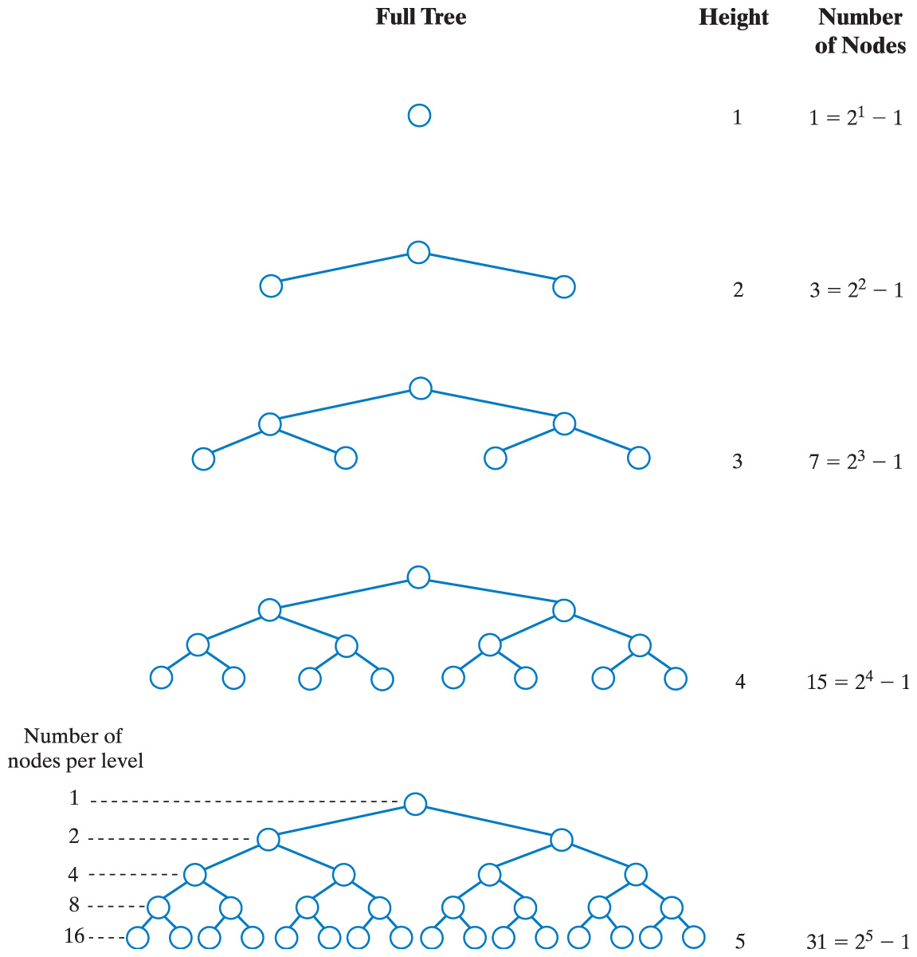
Binary Trees
The number of nodes in a full binary tree as a function of the tree's height.

Slide 15
Binary Trees
Full Tree Height Number of Nodes
The height of a binary tree with n nodes that is either complete or full is log₂(n + 1)
To compute log₂(x) in Java, first observe that log_{a}(x)=log_{b}(x)/log_{b}(a)
In Java Math.log(x) returns the natural logarithm of x. So Math.log(x)/Math.log(2.0) computes the base 2 logarithm of x

Slide 16
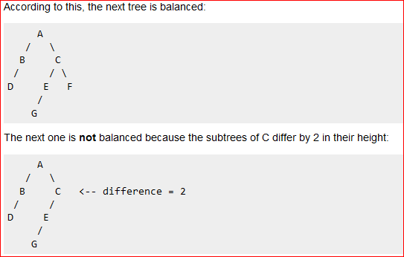
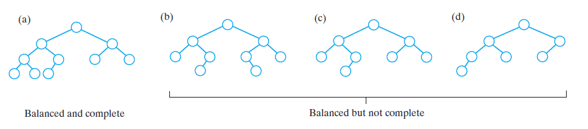
Binary Trees
A tree is height balanced if :
The left and right subtrees' heights differ by at most one, AND
The left subtree is balanced, AND
The right subtree is balanced

Slide 17
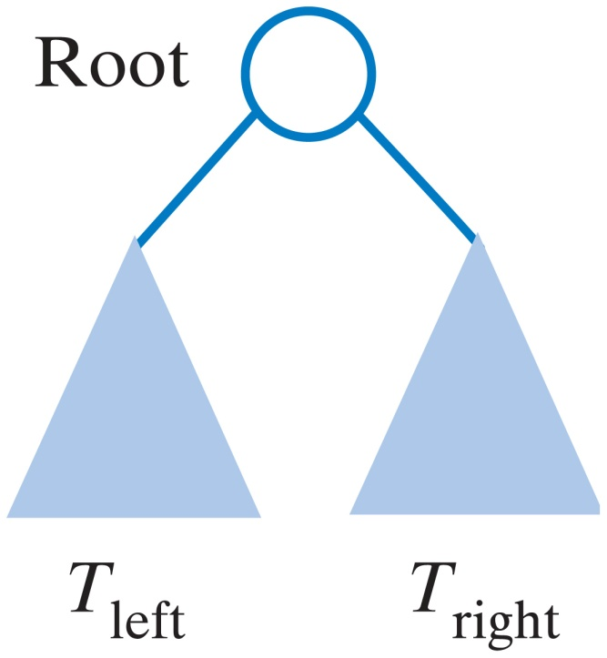
Traversals of a Tree
Visiting a node
Processing the data within a node
Must visit/process each data item exactly once
Nodes can be visited in different orders
For a binary tree visiting defined recursively:
Visit the root
Visit all nodes in root’s left subtree
Visit all nodes in root’s right subtree
Could visit root before, between, or after subtrees

Slide 18
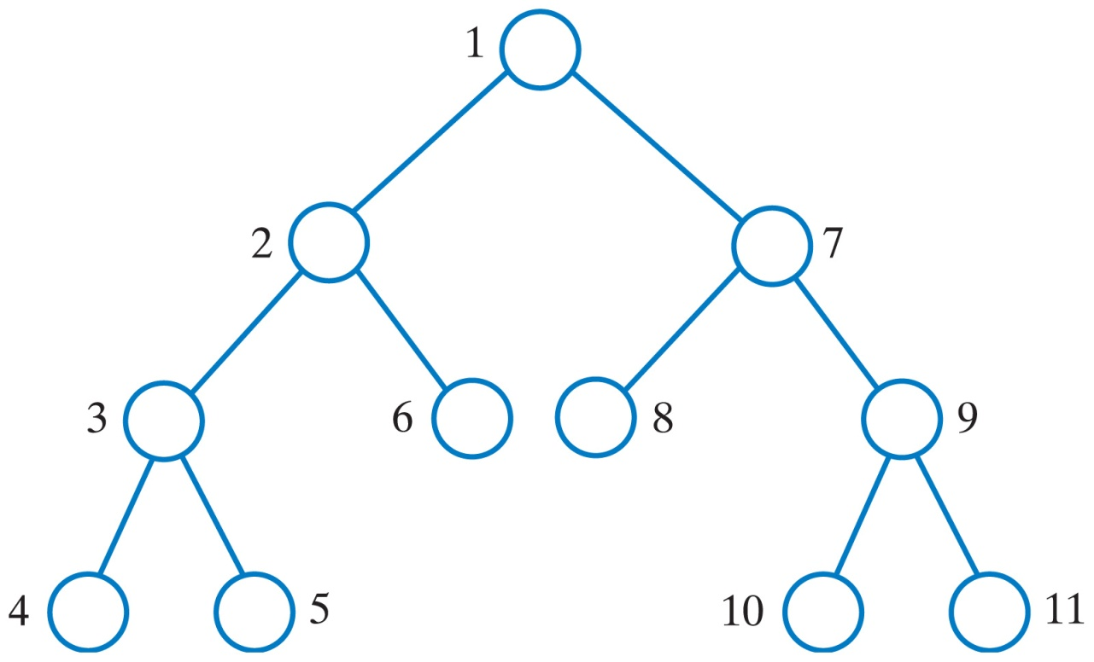
Traversals of a Tree
Preorder traversal: visit root before the subtrees
A
B
C
D
E
F
G
H
I
J
K
The visitation order of a preorder traversal.

Slide 19
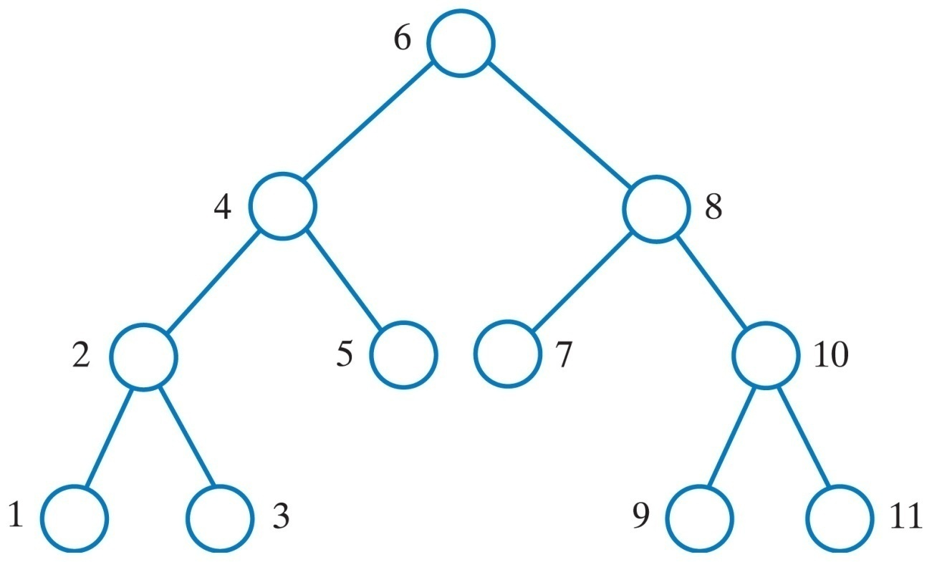
Traversals of a Tree
Inorder traversal: visit root between visiting the subtrees
A
B
C
D
E
F
G
H
I
J
K
The visitation order of an inorder traversal.

Slide 20
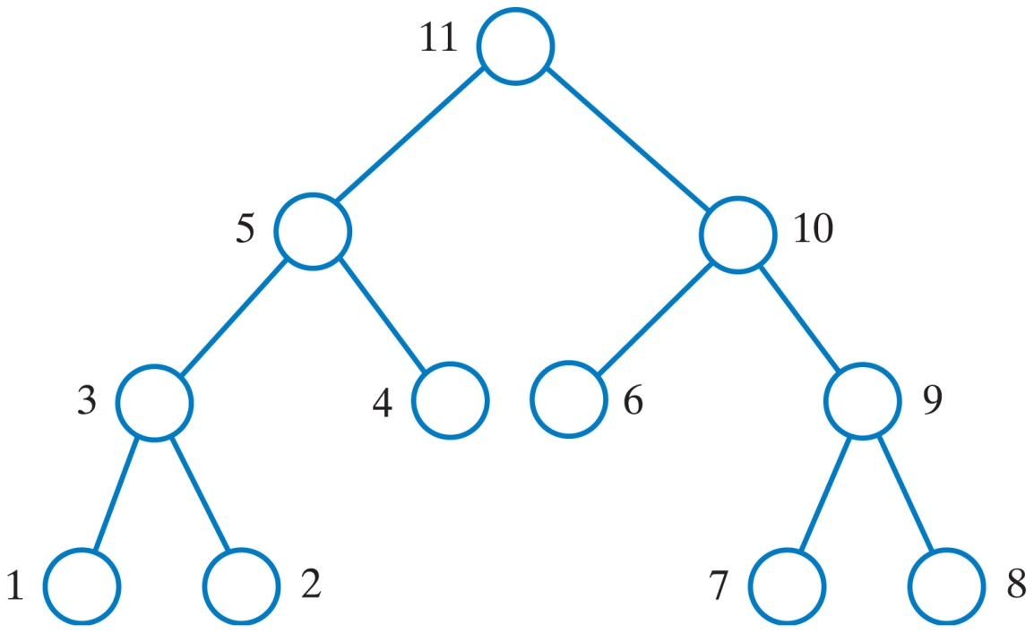
Traversals of a Tree
Postorder traversal: visit root after visiting the subtrees
These are examples of a depth-first traversal
A
B
C
D
E
F
G
H
K
I
J
The visitation order of a postorder traversal.

Slide 21
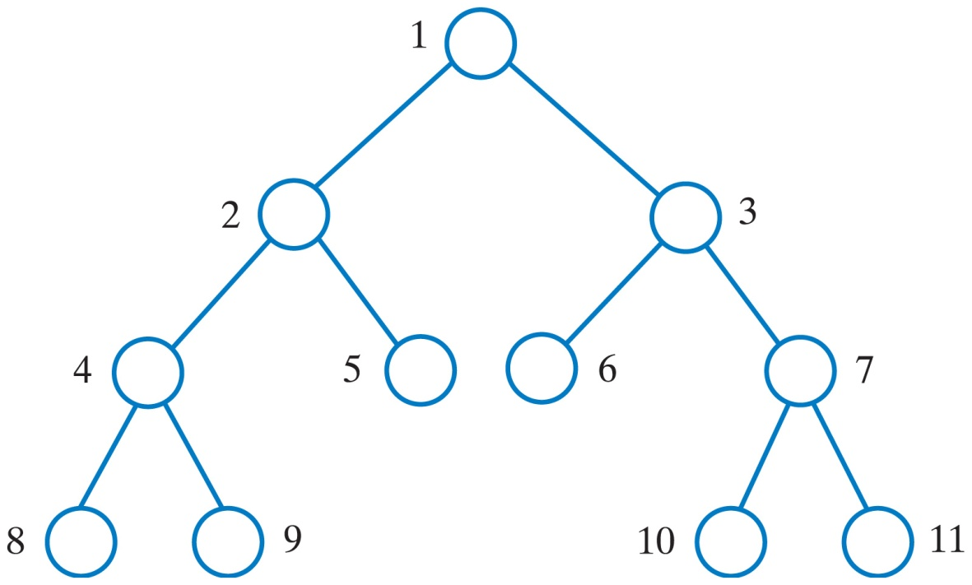
Traversals of a Tree
Level-order traversal: begin at the root, visit nodes one level at a time
This is an example of a breadth-first traversal.
The visitation order of a level-order traversal.

Slide 22
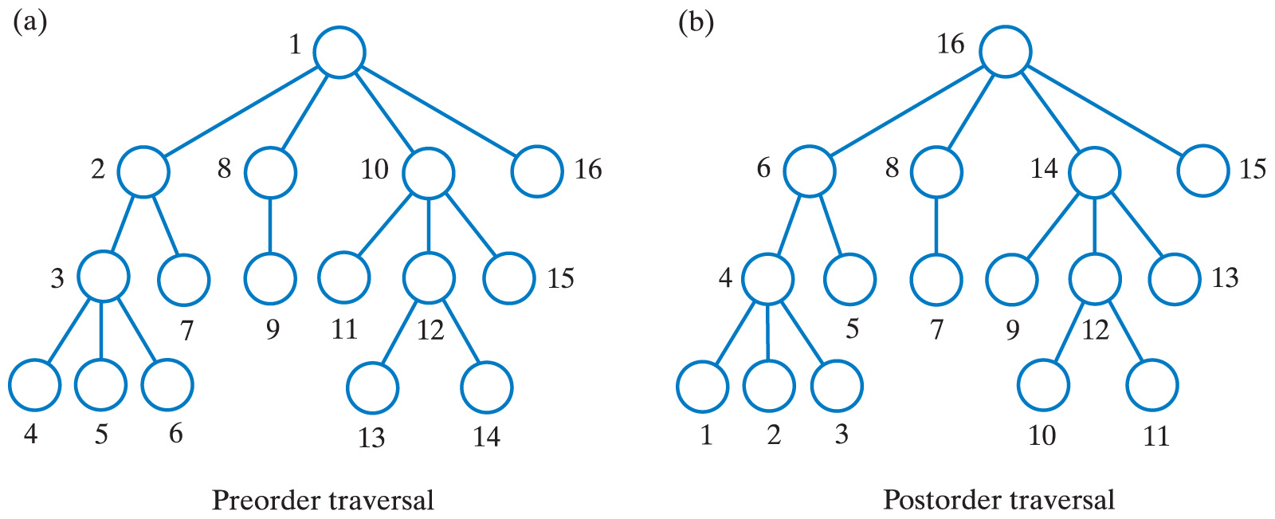
Traversals of a General Tree
A general tree has traversals that are in
Level order
Preorder (a)
Postorder (b)
Inorder traversal not well defined for a general tree

Slide 23
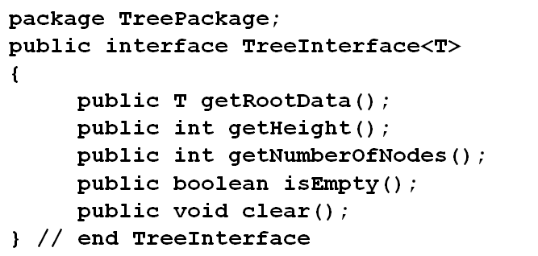
Fundamental Operations for Trees
Example of an interface that specifies operations common to all trees:

Slide 24
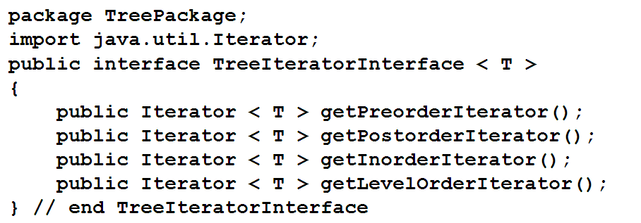
Fundamental Operations for Trees
Example of an interface of traversal methods for a tree

Slide 25
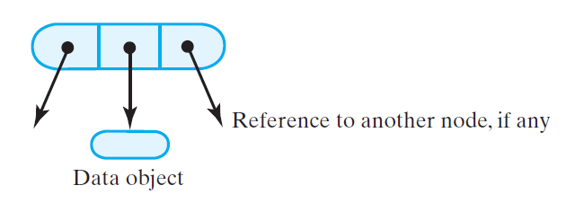
Nodes in a Binary Tree

Slide 26
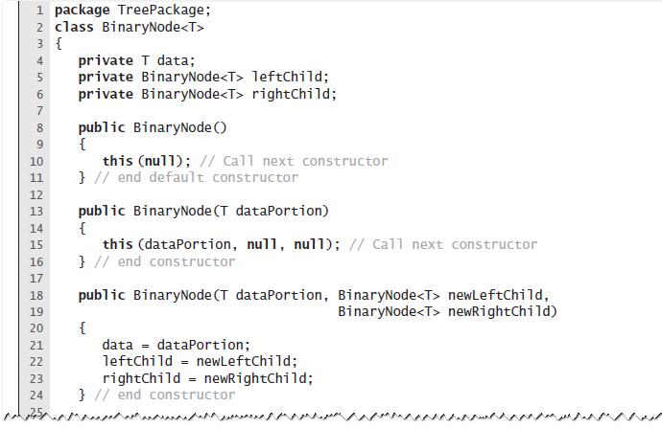
The class BinaryNode

Slide 27
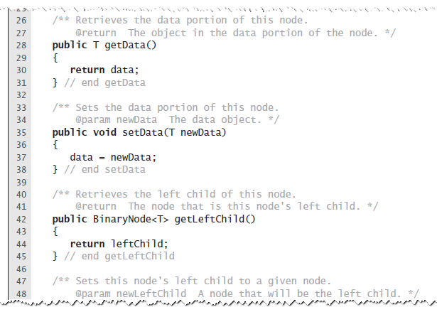
The class BinaryNode

Slide 28
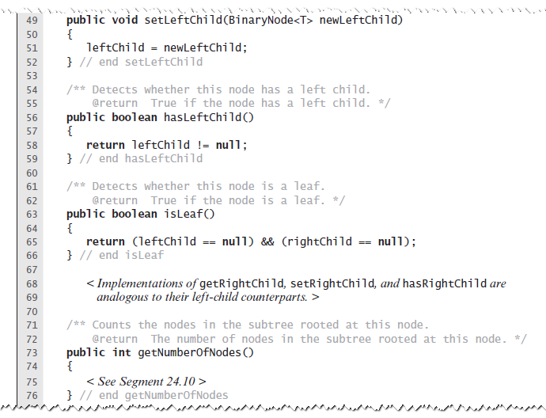
The class BinaryNode

Slide 29
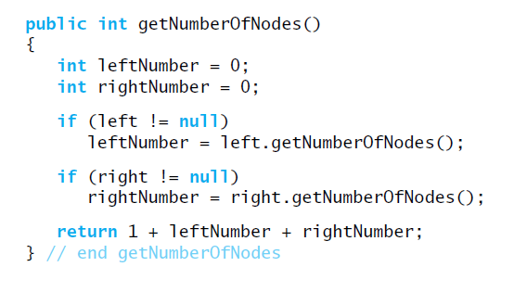
Method getNumberOfNodes implemented recursively
Alternate version
public int getNumberOfNodes() { return 1 + (this.leftChild != null ? this.leftChild.getNumberOfNodes() : 0) + (this.rightChild != null ? this.rightChild.getNumberOfNodes() : 0); } // end getNumberOfNodes

Slide 30
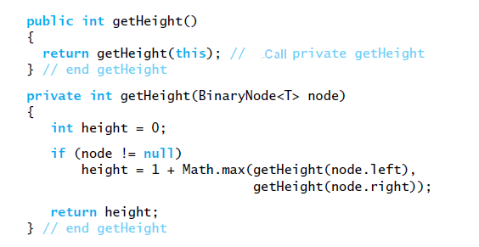
The class BinaryNode - recursive method getHeight
private int getHeight(BinaryNode<T> node) { if (node != null) return 1 + Math.max(getHeight(node.getLeftChild()), getHeight(node.getRightChild())); return 0; } // end getHeight
Alternate version

Slide 31
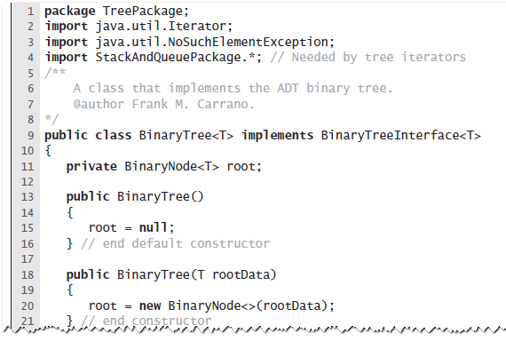
Creating a Basic Binary Tree

Slide 32
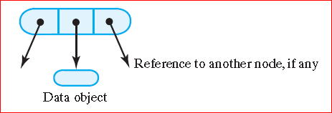
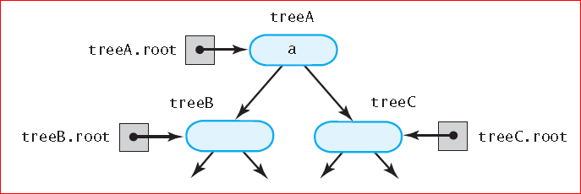
Binary Tree Implementations
The most common implementation of a tree uses a linked structure:
A node in a binary tree:
The binary tree treeA shares nodes with treeB and treeC:

Slide 33
Example of Binary Tree
// represent each leaf as a one-node tree
BinaryTreeInterface<String> dTree = new BinaryTree<String> ();
dTree.setTree("D");
BinaryTreeInterface<String> fTree = new BinaryTree<String> ();
fTree.setTree("F");
BinaryTreeInterface<String> gTree = new BinaryTree<String> ();
gTree.setTree("G");
BinaryTreeInterface<String> emptyTree = new BinaryTree<String> ();
BinaryTreeInterface<String> hTree = new BinaryTree<String> ();
hTree.setTree("H");
// form larger subtrees
BinaryTreeInterface<String> eTree = new BinaryTree<String> ();
eTree.setTree("E", fTree, gTree); // subtree rooted at E
BinaryTreeInterface<String> bTree = new BinaryTree<String> ();
bTree.setTree("B", dTree, eTree); // subtree rooted at B
BinaryTreeInterface<String> cTree = new BinaryTree<String> ();
cTree.setTree("C", emptyTree, hTree); // subtree rooted at C
BinaryTreeInterface<String> aTree = new BinaryTree<String> ();
aTree.setTree("A", bTree, cTree); // desired tree rooted at A

Slide 34
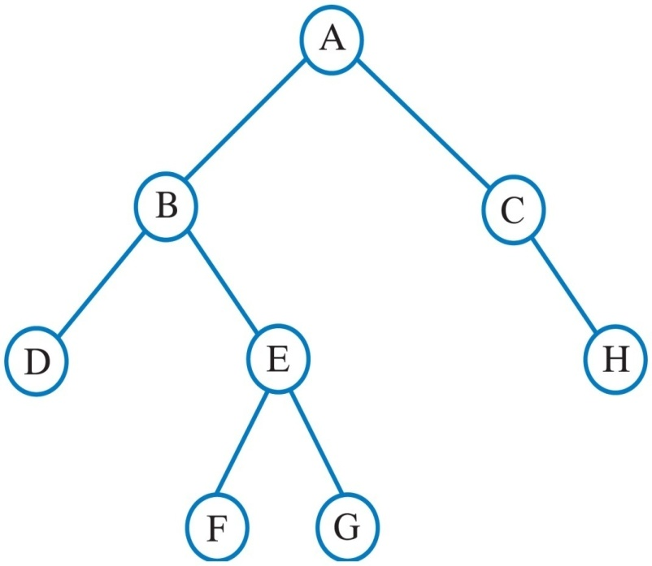
Example cnt.
The following binary tree is produced:
// display root, height, number of nodes
System.out.println("Root of tree contains " + aTree.getRootData());
System.out.println("Height of tree is " + aTree.getHeight());
System.out.println("Tree has " + aTree.getNumberOfNodes() + " nodes");
// display nodes in preorder
System.out.print("A preorder traversal visits nodes in this order:");
Iterator<String> preorder = aTree.getPreorderIterator();
while (preorder.hasNext())
System.out.print(preorder.next() + " ");

Slide 35
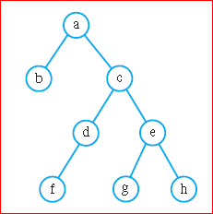
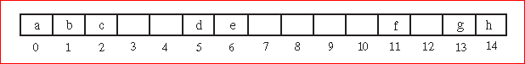
Binary Tree Implementations
Another way of representing a binary tree is to use an array.
The items in the tree are assigned locations in the array in a level-order fashion
Notice that gaps in the array correspond to missing nodes in the tree:
What are the indices of the children of the node stored at index i?
The left child is located at index 2i + 1, and the right child is at index 2i + 2.
What is the parent of the node stored at index i?
The parent is the node at index (i – 1) ⁄ 2.
What are the advantages and disadvantages of this representation?
The advantage of this representation is that it allows one to save the space needed for the two links in the nodes and to find “relatives” quickly.
The disadvantage is that it wastes space if the tree is not close to complete.

Slide 36
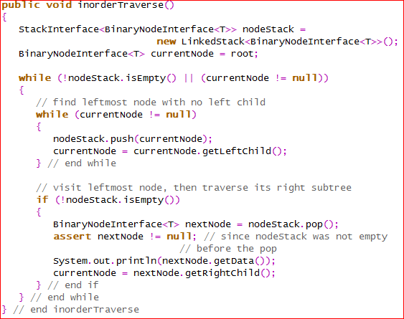
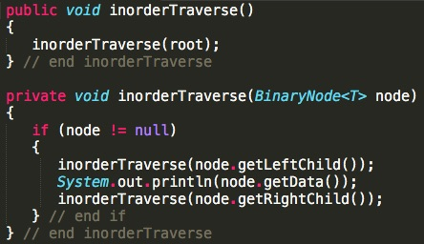
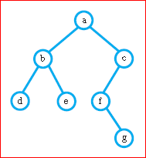
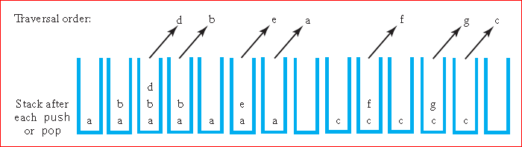
Which data structures could be used to implement iterators?
iterative
recursive
Inorder traversal

Slide 37
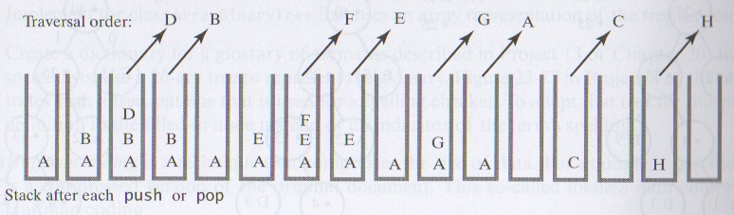
Trace inorderTraverse method with the following tree:

Slide 38
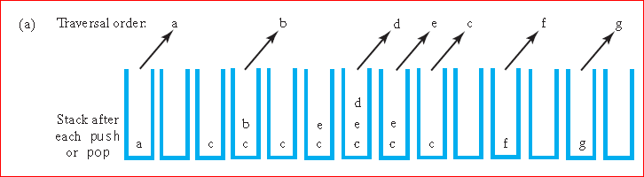
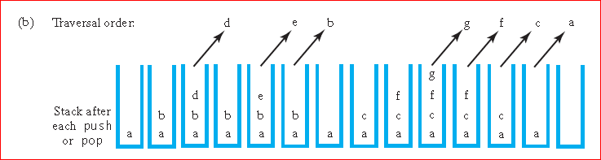
Which data structures could be used to implement iterators?
Preorder traversal (pushes a node’s children onto the stack in the opposite order)
Postorder traversal

Slide 39
Which data structures could be used to implement iterators?
Level order traversal:
implemented with a queue
first enqueues the root
while the queue is not empty:
dequeues a node
visits the node
enqueues the node’s children

Slide 40
Expression Trees
Use binary tree to represent expressions
Two operands
One binary operator
The operator is the root
Can be used to evaluate an expression
Post order traversal
Each operand, then the operator

Slide 41
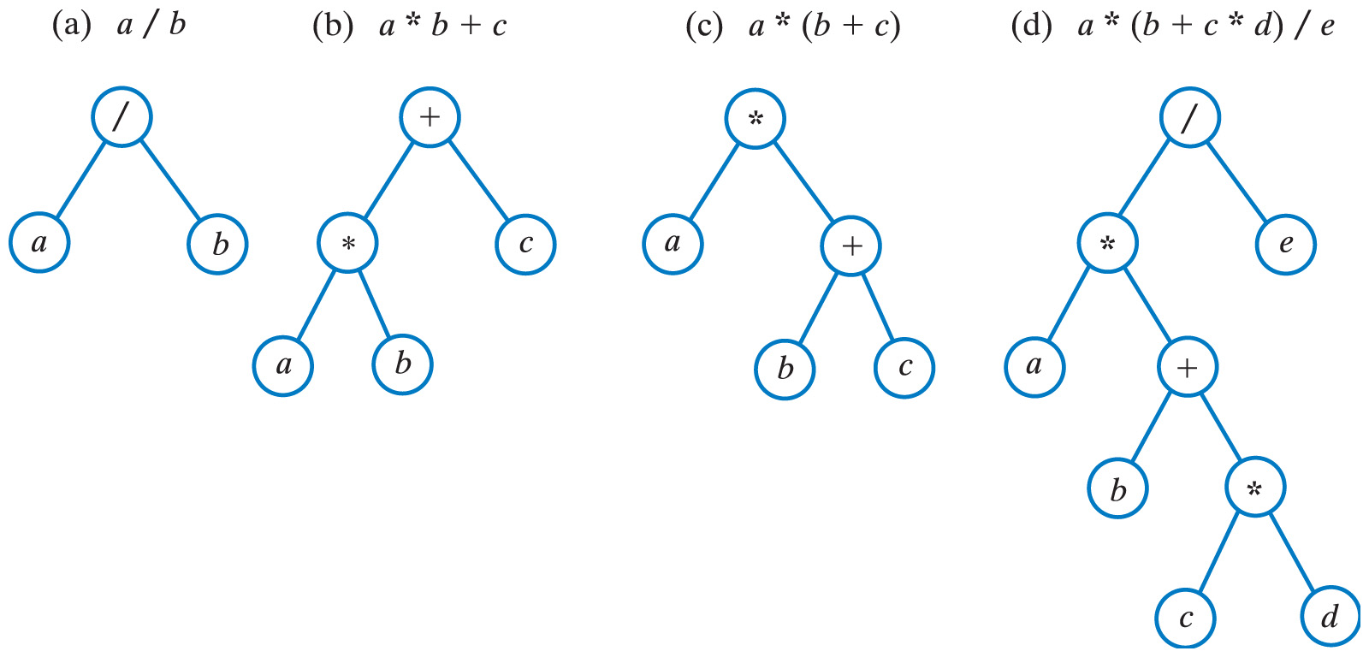
Expression Trees for Algebraic Expressions
Which traversal order would you use to evaluate an algebraic expression?
postorder traversal – need to know the values of the operands before we can perform the operation
Draw the Expression Tree for: (a * b + c * d) / e

Slide 42
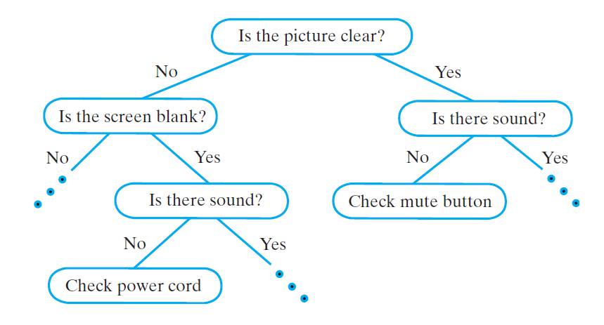
Decision Trees
Used for expert systems
Helps users solve problems
Parent node asks question
Child nodes provide conclusion or further question
Decision trees are generally n-ary
Expert system application often binary
Note interface for decision tree, Listing 23-4

Slide 43
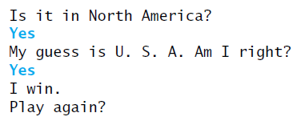
Decision Trees
Consider a guessing game
Program asks yes/no questions
Adds to its own decision tree as game progresses
Example
View class GuessingGame, Listing 23-5

Slide 44
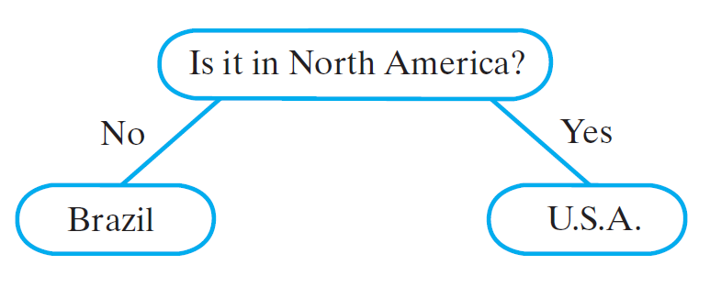
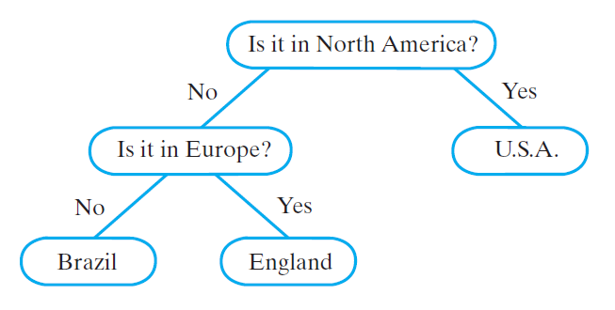
Building decision tree for a guessing game

Slide 45
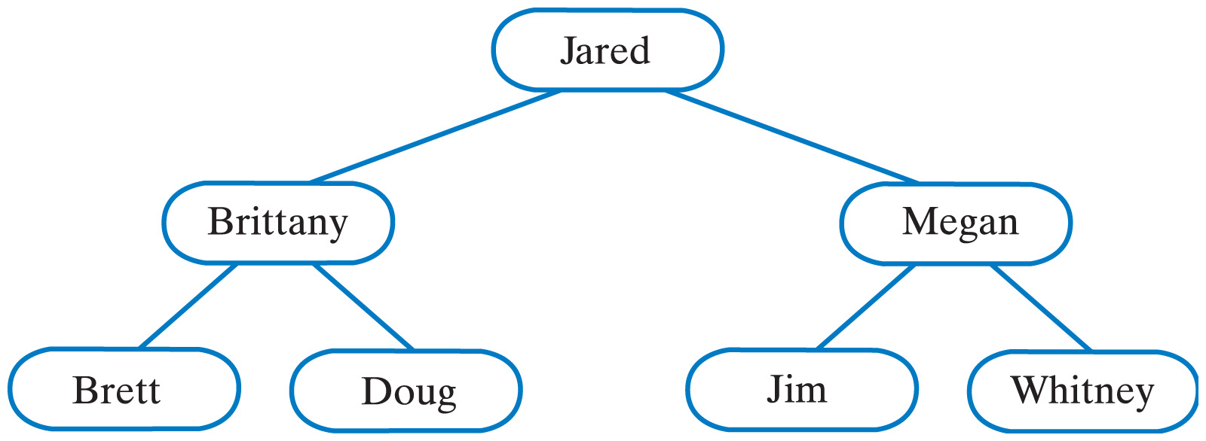
Binary Search Trees
A search tree organizes its data so that a search is more efficient
Binary search tree
Nodes contain Comparable objects
A node's data is greater than the data in the node's left subtree
A node's data is less than the data in the node's right subtree
Assuming no duplicates for now
demo
demo2

Slide 46
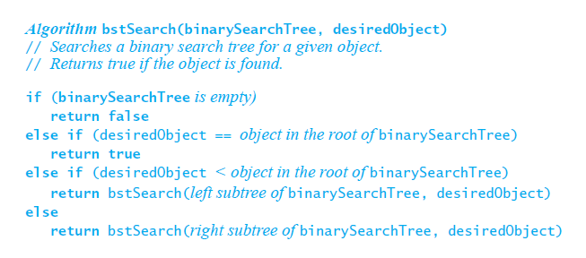
Binary Search Trees
Pseudocode for recursive search algorithm

Slide 47
Binary Search Trees
Efficiency of a search
Searching a binary search tree of height h is O(h)
To make searching a binary search tree as efficient as possible …
Tree must be as short as possible.

Slide 48
Java Class Library: The Class TreeSet
Implements interface Set
elements are ordered using their natural ordering, or by comparator provided at the set creation time (depending on which constructor is used)
does not allow duplicates
The iterators returned by this class's iterator method are fail-fast:
if the set is modified at any time after the iterator is created, in any way except through the iterator's own remove method, the iterator will throw a ConcurrentModificationException.
Demo
how about: “the quick fox jumps over the lazy brown dog"

Slide 49
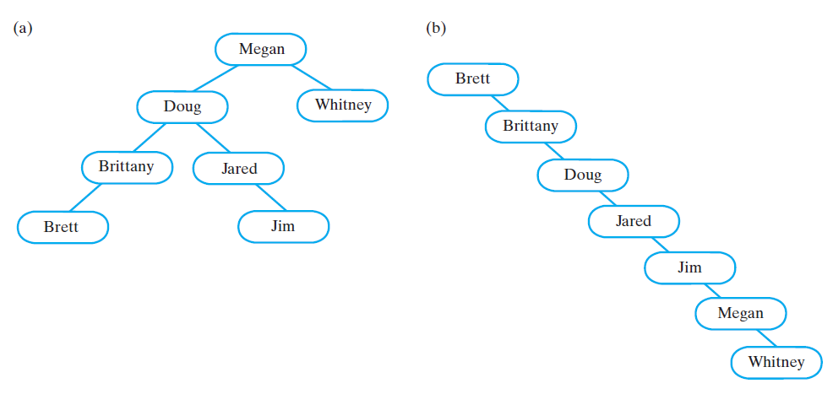
Question
Draw a binary search tree that would be created by adding the following items: Megan, Whitney, Doug, Jared, Brittany, Brett, Jim
Draw a binary search tree that would be created by adding the same items but given in alphabetical order: Brett, Brittany, Doug, Jared, Jim, Megan, Whitney

Slide 50
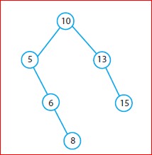
Question
Draw a binary search tree that would be created by adding the following items: 10, 5, 6, 13, 15, 8.
What ordering of the items: 10, 5, 6, 13, 15, 8, 14, 7, 12,4 would result in the most balanced tree if they were added to an initially empty binary search tree?
Several orderings will each result in a tree that is almost perfectly balanced. For example, each of the following orderings will result in a tree such that every node has left and right subtrees whose heights differ by no more than 1:
10, 6, 5, 8, 4, 7, 14, 13, 15, 12
8, 6, 13, 5, 7, 12, 14, 4, 10, 15

Slide 51
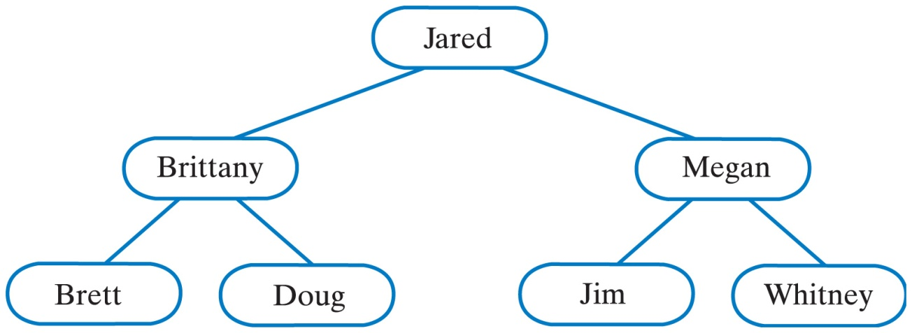
Question
Consider existing binary search tree:
Add names Chris, Jason, and Kelly to the above tree
Add name Miguel to the original tree and then add Nancy
Add name Nancy to the original tree and then add Miguel

Slide 52
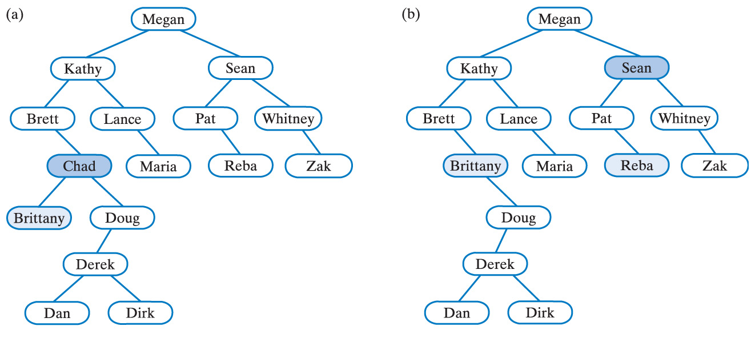
Example - Removing a node
To remove a node that has children we replace it with its in-order predecessor

Slide 53
Examples of General Trees: Parse Tree
Example of rules for algebraic expressions:
An algebraic expression is either a term or two terms separated by a + or – operator
A term is either a factor or two factors separated by a * or / operator
A factor is either a variable or an algebraic expression enclosed in parenthesis
A variable is a single letter
The following notation - Backus-Naur Form (BNF) - would be used to define the above grammar:
<expression>::=<term>|<term>+<term>|<term>-<term>
<term>::=<factor>|<factor>*<factor>|<factor>/<factor>
<factor>::=<variable>|(<expression>)
<variable>::=a|b|…|z|A|B|…|Z

Slide 54
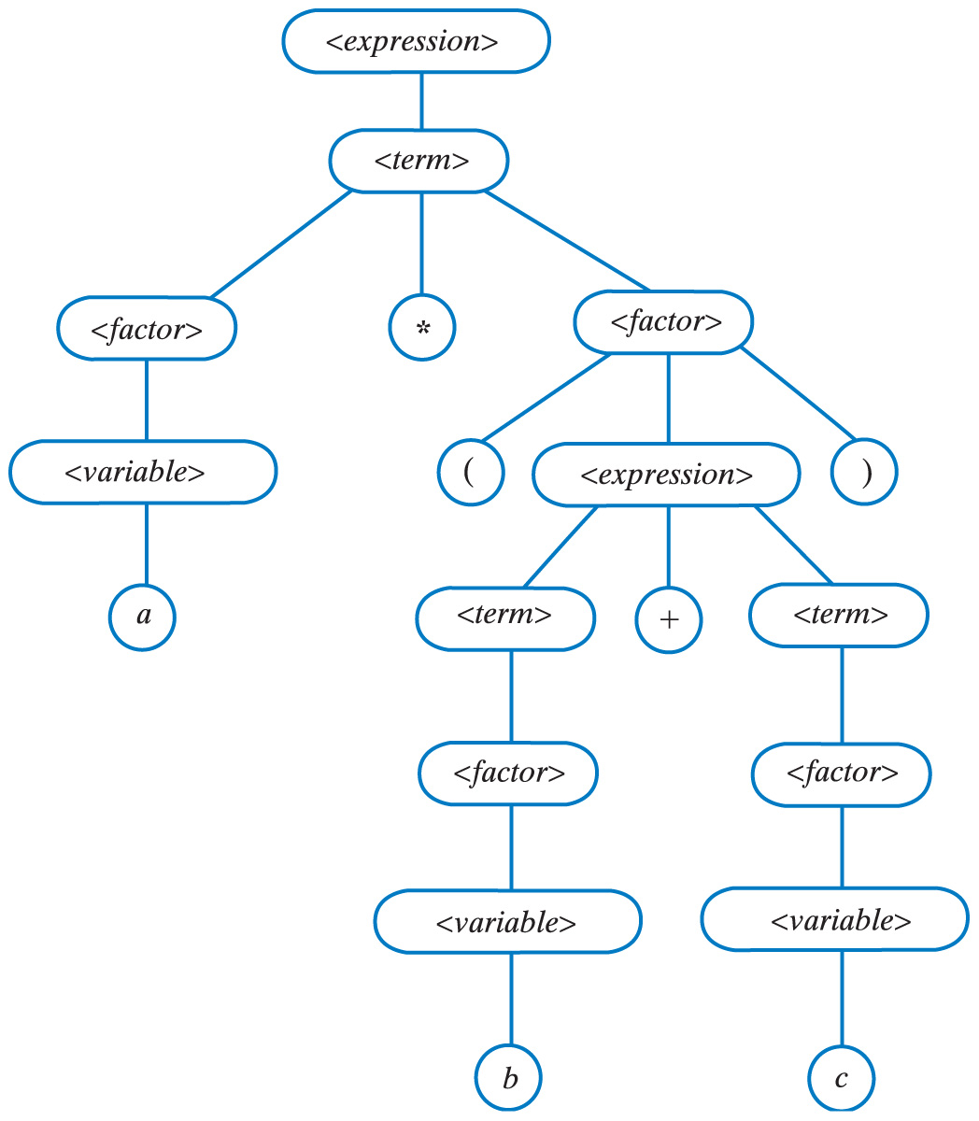
Examples of General Trees: Parse Tree
How to check if the given string a * (b + c) is an algebraic expression?
See if we can create a parse tree for that expression based on the grammar rules:
<expression>::=<term>|<term>+<term>|<term>-<term>
<term>::=<factor>|<factor>*<factor>|<factor>/<factor>
<factor>::=<variable>|(<expression>)
<variable>::=a|b|…|z|A|B|…|Z

Slide 55
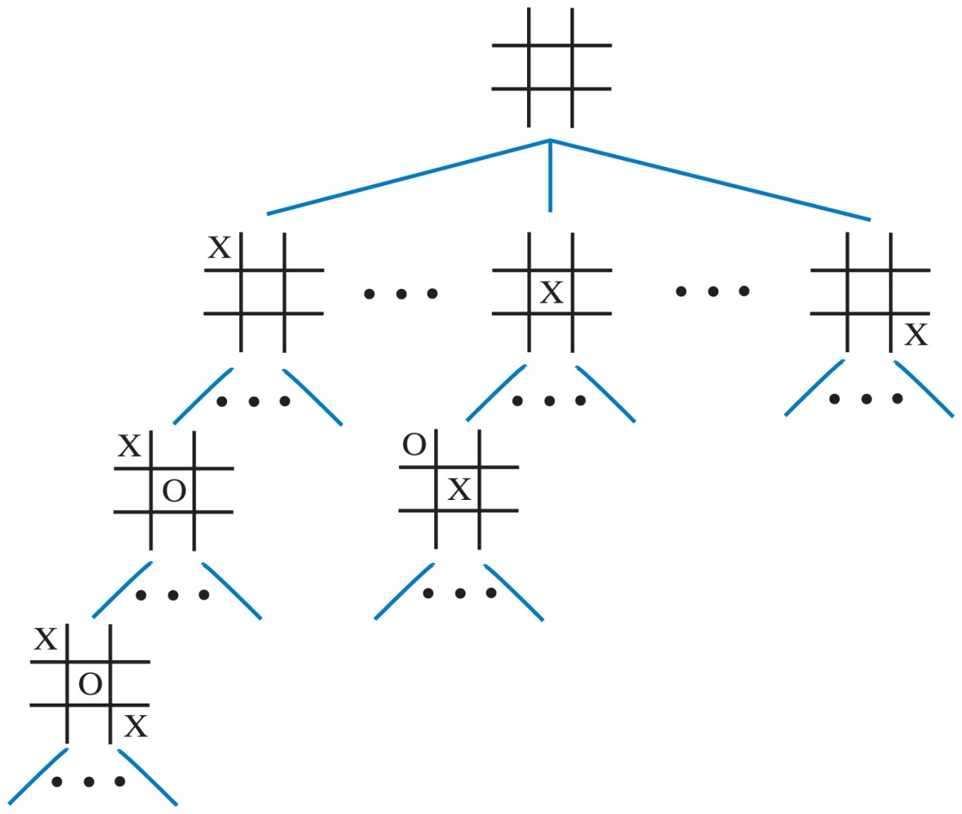
Examples of General Trees: Game Tree
A portion of a game tree for tic-tac-toe
http://en.wikipedia.org/wiki/Deep_Blue_versus_Garry_Kasparov

Slide 56

Heaps
Heap is a complete binary tree
Nodes contain Comparable objects
Maxheap (a)
Object in a node is ≥ its descendant objects
Minheap (b)
Object in a node is ≤ descendant objects

Slide 57

Priority Queues
Use a heap to implement the ADT priority queue
Assume class MaxHeap implements MaxHeapInterface:
View class PriorityQueue, Listing 23-7

Slide 58

Using an Array to Represent a Heap
When a binary tree is complete
Can use level-order traversal to store data in consecutive locations of an array
Enables easy location of the data in a node's parent or children
Parent of a node at i is found at i/2 (unless i is 1)
Children of node at i found at indices 2i and 2i + 1

Slide 59
Using an Array to Represent a Heap
View code of class MaxHeap, Listing 26-1
Data fields:
Array of Comparable heap entries
Index of last entry in the array
A constant for default initial capacity of heap

Slide 60

Class MaxHeap
The steps in adding 85 to the maxheap

Slide 61


Class MaxHeap
To avoid swaps:
Begin at next available position for a leaf
Follow path from this leaf toward root until correct position for new entry is found
As this is done
Move entries from parent to child
Makes room for new entry

Slide 62

Adding an Entry
An array representation of the steps from the previous slide

Slide 63
Adding an Entry
(ctd.) An array representation of the from the previous slide.

Slide 64

Creating a Heap
The steps in adding 20, 40, 30, 10, 90, and 70 to a heap.

Slide 65

Removing the Root
The steps to remove the entry in the root of the maxheap

Slide 66

Transforming a Semiheap into a Heap without Swaps

Slide 67

Creating a Heap
The steps in creating a heap by using reheap.

Slide 68
Heapsort
Possible to use a heap to sort an array
Place array items into a maxheap
Then remove them
Items will be in descending order
Place them back into the original array and they will be in order

Slide 69

Heapsort
Place array items into a maxheap
Then remove them one by one
Items will be in descending order
Place them back into the original array and they will be in order

Slide 70
Heapsort
Place array items into a maxheap
Then remove them one by one
Items will be in descending order
Place them back into the original array and they will be in order

Slide 71

Efficiency
HeapSort - https://www.youtube.com/watch?v=iXAjiDQbPSw
QuickSort - https://www.youtube.com/watch?v=m1PS8IR6Td0

Slide 72

A Holiday Tree with a Heap of Presents Underneath
Is it a heap?

Slide 73
Question
Trace the steps that heapSort takes when sorting the following array:
9 6 2 4 8 7 5 3

Slide 74


Efficiency of Operations on Binary Trees
The order in which entries are added affect the shape of the binary tree
If entries are added to an empty binary tree
Best not to have them sorted first
Tree is more balanced if entries are in random order
Two binary search trees that contain the same data
Shorter tree has efficiency
O(log n)

Slide 75

Importance of Balance
Completely balanced
Subtrees of each node have exactly same height
Height balanced
Subtrees of each node in the tree differ in height by no more than one
AVL, black-red trees (among others) are used for balancing the height of a binary search tree

Slide 76
AVL Trees
AVL tree is a self-balancing binary search tree
Named after Adelson-Velsky and Landis
The first such data structure to be invented
Whenever it becomes unbalanced
Rearranges its nodes to get a balanced binary search tree
Balance of a binary search tree upset when
Add a node
Remove a node
Thus during these operations, the AVL tree must rearrange nodes to maintain balance

Slide 77

AVL Trees
In all our examples, we will be adding the following sequence:
60, 50, 20, 80, 90, 70, 55, 10, 40, and 35
After inserting 60; (b) 50; and (c) 20 into an initially empty binary search tree, the tree is not balanced;
(d) a corresponding AVL tree rotates its nodes to restore balance.

Slide 78

AVL Trees – cnt.
60, 50, 20, 80, 90, 70, 55, 10, 40, and 35
adding 80 to tree does not change the balance of the tree;
a subsequent addition of 90 makes tree unbalanced;
(c) left rotation restores balance.

Slide 79

Single Rotations
Before and after a right rotation restores balance to an AVL tree

Slide 80

Double Rotations
60, 50, 20, 80, 90, 70, 55, 10, 40, and 35
Adding 70 to the tree destroys its balance; to restore the balance, perform both
a right rotation and
a left rotation.

Slide 81
Java Class Library: The Class TreeMap
Extends interface Map
Similar to our interface for ADT dictionary
Specifies that search keys maintained in ascending order
Uses balanced binary search tree to implement methods
Efficiency of get, put, remove, containsKey
O(log n)

Slide 82
Notes on the Lab13 (see Lab13.docx for detailed algorithm that you need to follow)

Slide 83

Conceptual example of creating a binary tree for Huffman coding (see Chapter 24 project #9 on page 694)
Encoding some text composed only of the letters A through E, where these letters occur with the following frequencies: A 12, B 3, C 1, D 9, and E 15 times:
A 10
B 1101
C 1100
D 111
E 0
For this text the word DAD will be encoded as 11110111
What is the compression ratio?

Slide 84
Question
Create Huffman Tree for the word MISSISSIPPI
Create counters (must be arranged by ASCII values):
I 4
M 1
P 2
S 4
Create Huffman Tree
What is the binary encoding for this word?
100 11 0 0 11 0 0 11 101 101 11
M I S S I S S I P P I
What is the compression ratio?

Slide 85


Huffman Tree for “MISSISSIPPI”

